Slide 1
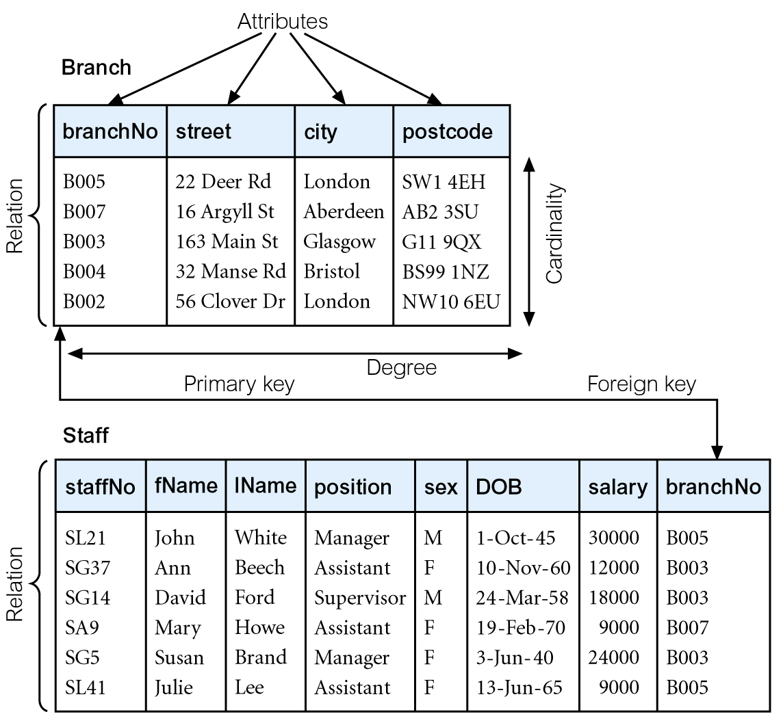
Instances of Branch and Staff Relations
Pearson Education © 2014

Slide 2
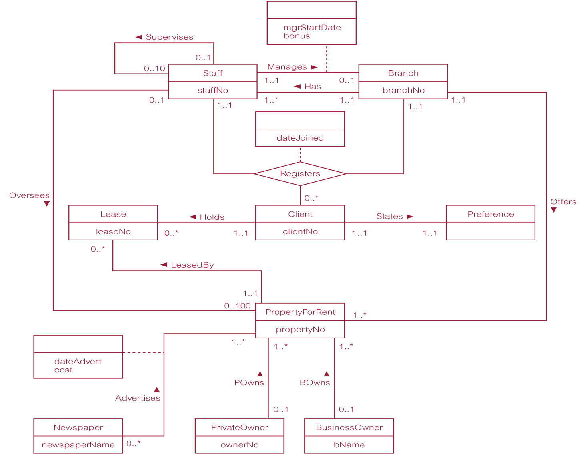
ER diagram of Branch user views of DreamHome

Slide 3
Chapter 6
SQL – Data Manipulation
Most important lesson in the course!
Pearson Education © 2014

Slide 4

Example 6.1 All Columns, All Rows
List full details of all staff.
SELECT staffNo, fName, lName, address,
  position, sex, DOB, salary, branchNo
  FROM Staff;
Can use * as an abbreviation for ‘all columns’:
  SELECT *
  FROM Staff;
Pearson Education © 2014

Slide 5
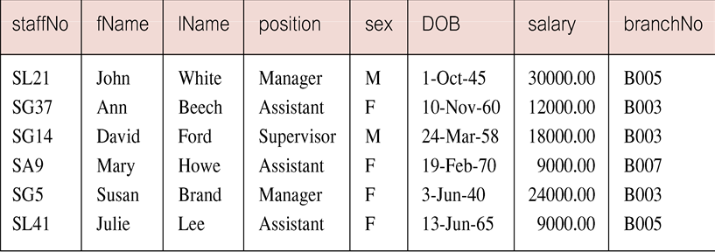
Example 6.1 All Columns, All Rows
Pearson Education © 2014

Slide 6
Example 6.2 Specific Columns, All Rows
Produce a list of salaries for all staff, showing only staff number, first and last names, and salary.
  SELECT staffNo, fName, lName, salary
  FROM Staff;
Pearson Education © 2014

Slide 7
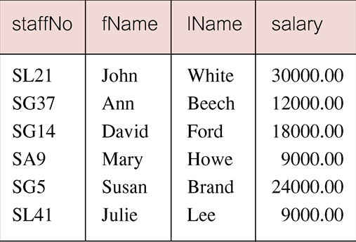
Example 6.2 Specific Columns, All Rows
Pearson Education © 2014

Slide 8
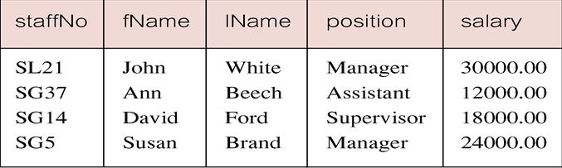
Example 6.5 Comparison Search Condition
List all staff with a salary greater than 10,000.
SELECT staffNo, fName, lName, position, salary
  FROM Staff
  WHERE salary > 10000;
Where clause is equivalent to which relational algebra operation?
Pearson Education © 2014

Slide 9
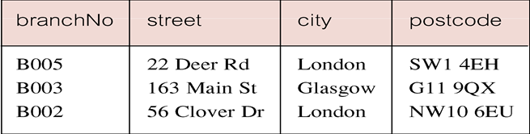
Example 6.6 Compound Comparison Search Condition
List addresses of all branch offices in London or Glasgow.
SELECT *
  FROM Branch
  WHERE city = ‘London’ OR city = ‘Glasgow’;
Pearson Education © 2014

Slide 10
Example 6.7 Range Search Condition
List all staff with a salary between 20,000 and 30,000.
SELECT staffNo, fName, lName, position, salary
  FROM Staff
  WHERE salary BETWEEN 20000 AND 30000;
BETWEEN test includes the endpoints of range.
Pearson Education © 2014

Slide 11
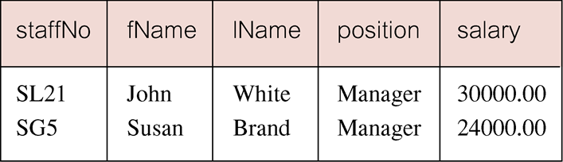
Example 6.7 Range Search Condition
Pearson Education © 2014

Slide 12
Example 6.7 Range Search Condition
Also a negated version NOT BETWEEN.
BETWEEN does not add much to SQL’s expressive power. Could also write:
SELECT staffNo, fName, lName, position, salary
  FROM Staff
  WHERE salary>=20000 AND salary <= 30000;
Useful, though, for a range of values.
Pearson Education © 2014

Slide 13
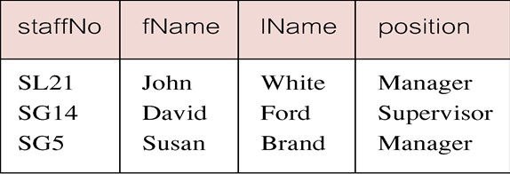
Example 6.8 Set Membership
List all managers and supervisors.
  SELECT staffNo, fName, lName, position
  FROM Staff
  WHERE position IN (‘Manager’, ‘Supervisor’);
Pearson Education © 2014

Slide 14
Example 6.8 Set Membership
There is a negated version (NOT IN).
IN does not add much to SQL’s expressive power. Could have expressed this as:
  SELECT staffNo, fName, lName, position
  FROM Staff
  WHERE position=‘Manager’ OR
  position=‘Supervisor’;
IN is more efficient when set contains many values.
Pearson Education © 2014

Slide 15
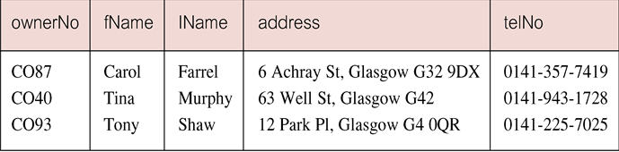
Example 6.9 Pattern Matching
Find all owners with the string ‘Glasgow’ in their address.
SELECT ownerNo, fName, lName, address, telNo
  FROM PrivateOwner
  WHERE address LIKE ‘%Glasgow%’;
Pearson Education © 2014

Slide 16

Example 6.9 Pattern Matching
SQL has two special pattern matching symbols:
  %: sequence of zero or more characters;
  _ (underscore): any single character.
LIKE ‘%Glasgow%’ means a sequence of characters of any length containing ‘Glasgow’.
LIKE ‘Glasgow%’ means a sequence of characters of any length starting with ‘Glasgow’. (Could also do ‘%Glasgow’, ends with ‘Glasgow’.)
Pearson Education © 2014

Slide 17
Example 6.10 NULL Search Condition
List details of all viewings on property PG4 where a comment has not been supplied.
There are 2 viewings for property PG4, one with and one without a comment.
Have to test for null explicitly using special keyword IS NULL:
SELECT clientNo, viewDate
  FROM Viewing
  WHERE propertyNo = ‘PG4’ AND
  comment IS NULL;
Pearson Education © 2014

Slide 18
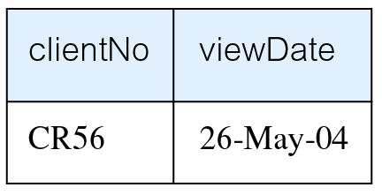
Example 6.10 NULL Search Condition
Negated version (IS NOT NULL) can test for non-null values.
Pearson Education © 2014

Slide 19
Example 6.11 Single Column Ordering
List salaries for all staff, arranged in descending order of salary.
SELECT staffNo, fName, lName, salary
  FROM Staff
  ORDER BY salary DESC;
Pearson Education © 2014

Slide 20
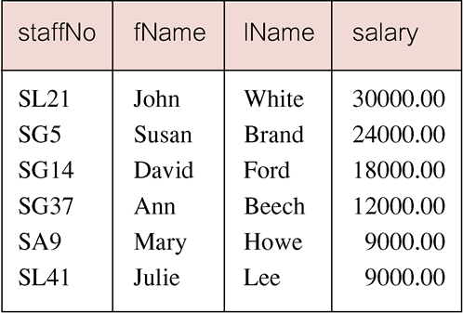
Example 6.11 Single Column Ordering
Pearson Education © 2014

Slide 21
Example 6.12 Multiple Column Ordering
Produce abbreviated list of properties in order of property type.
SELECT propertyNo, type, rooms, rent
  FROM PropertyForRent
  ORDER BY type;
Pearson Education © 2014

Slide 22
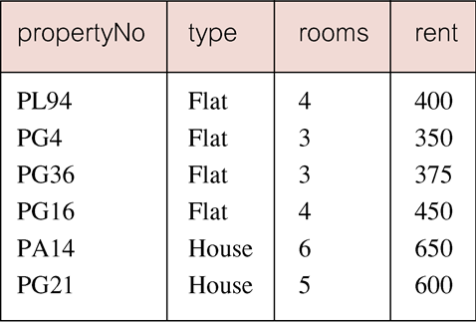
Example 6.12 Multiple Column Ordering
Pearson Education © 2014

Slide 23
Example 6.12 Multiple Column Ordering
Four flats in this list - as no minor sort key specified, system arranges these rows in any order it chooses.
To arrange in order of rent, specify minor order:
SELECT propertyNo, type, rooms, rent
  FROM PropertyForRent
  ORDER BY type, rent DESC;
Pearson Education © 2014

Slide 24
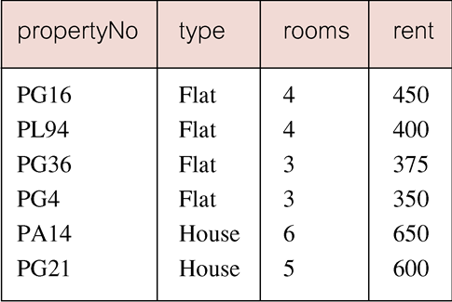
Example 6.12 Multiple Column Ordering
Pearson Education © 2014

Slide 25
SELECT Statement - Aggregates
ISO standard defines five aggregate functions:
COUNT returns number of values in specified column.
SUM returns sum of values in specified column.
AVG returns average of values in specified column.
MIN returns smallest value in specified column.
MAX returns largest value in specified column.
Pearson Education © 2014

Slide 26
SELECT Statement - Aggregates
Each operates on a single column of a table and returns a single value.
COUNT, MIN, and MAX apply to numeric and non-numeric fields, but SUM and AVG may be used on numeric fields only.
Apart from COUNT(*), each function eliminates nulls first and operates only on remaining non-null values.
Pearson Education © 2014

Slide 27
SELECT Statement - Aggregates
COUNT(*) counts all rows of a table, regardless of whether nulls or duplicate values occur.
Can use DISTINCT before column name to eliminate duplicates.
DISTINCT has no effect with MIN/MAX, but may have with SUM/AVG.
Pearson Education © 2014

Slide 28
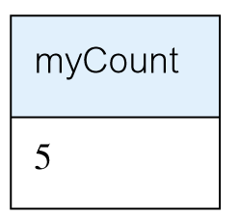
Example 6.13 Use of COUNT(*)
How many properties cost more than £350 per month to rent?
SELECT COUNT(*) AS myCount
  FROM PropertyForRent
  WHERE rent > 350;
Pearson Education © 2014

Slide 29
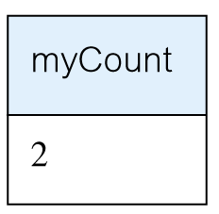
Example 6.14 Use of COUNT(DISTINCT)
How many different properties viewed in May ‘13?
SELECT COUNT(DISTINCT propertyNo) AS myCount
  FROM Viewing
  WHERE viewDate BETWEEN ‘1-May-13’
  AND ‘31-May-13’;
Pearson Education © 2014

Slide 30
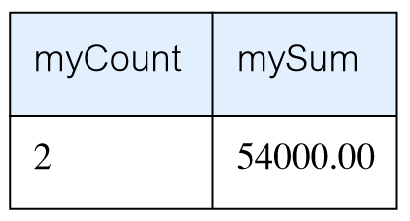
Example 6.15 Use of COUNT and SUM
Find number of Managers and sum of their salaries.
SELECT COUNT(staffNo) AS myCount,
  SUM(salary) AS mySum
  FROM Staff
  WHERE position = ‘Manager’;
Pearson Education © 2014

Slide 31
To get the Total rows in any table, could do something like
Select count(*)
From Staff

Slide 32
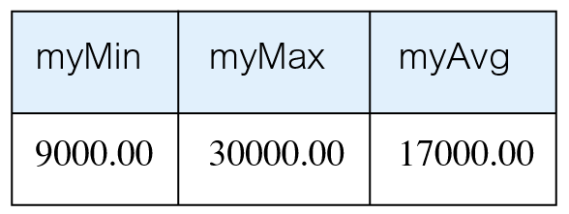
Example 6.16 Use of MIN, MAX, AVG
Find minimum, maximum, and average staff salary.
SELECT MIN(salary) AS myMin,
  MAX(salary) AS myMax,
  AVG(salary) AS myAvg
  FROM Staff;
Pearson Education © 2014

Slide 33
SELECT Statement - Grouping
Use GROUP BY clause to get sub-totals.
SELECT and GROUP BY closely integrated: each item in SELECT list must be single-valued per group, and SELECT clause may only contain:
  column names
  aggregate functions
  constants
  expression involving combinations of the above.
Pearson Education © 2014

Slide 34
SELECT Statement - Grouping
All column names in SELECT list must appear in GROUP BY clause unless name is used only in an aggregate function.
If WHERE is used with GROUP BY, WHERE is applied first, then groups are formed from remaining rows satisfying predicate.
ISO considers two nulls to be equal for purposes of GROUP BY.
Pearson Education © 2014

Slide 35
Example 6.17 Use of GROUP BY
Find number of staff in each branch and their total salaries.
  SELECT branchNo,
  COUNT(staffNo) AS myCount,
    SUM(salary) AS mySum
    FROM Staff
    GROUP BY branchNo
    ORDER BY branchNo;
Pearson Education © 2014

Slide 36
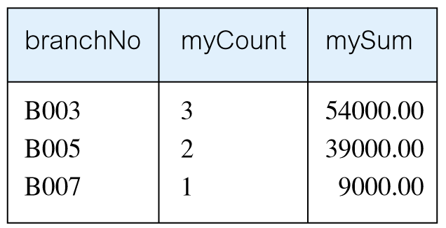
Example 6.17 Use of GROUP BY
Show the bottom illustration on page 162!!
Pearson Education © 2014

Slide 37
Example 6.18 Use of HAVING
For each branch with more than 1 member of staff, find number of staff in each branch and sum of their salaries.
  SELECT branchNo,
  COUNT(staffNo) AS myCount,
    SUM(salary) AS mySum
    FROM Staff
    GROUP BY branchNo
    HAVING COUNT(staffNo) > 1
    ORDER BY branchNo;
Pearson Education © 2014

Slide 38
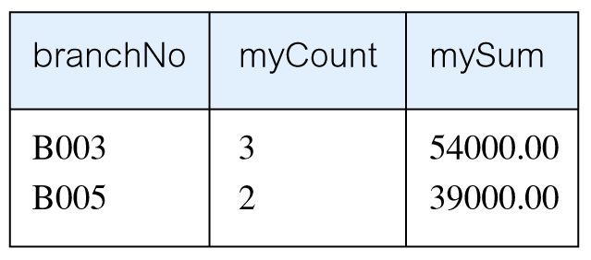
Example 6.18 Use of HAVING
Pearson Education © 2014

Slide 39
Example 6.19 Subquery with Equality
List staff who work in branch at ‘163 Main St’.
SELECT staffNo, fName, lName, position
  FROM Staff
  WHERE branchNo =
  (SELECT branchNo
  FROM Branch
  WHERE street = ‘163 Main St’);
Pearson Education © 2014

Slide 40
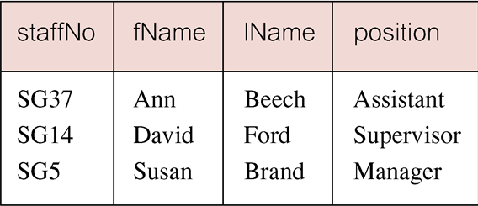
Example 6.19 Subquery with Equality
Pearson Education © 2014

Slide 41
Example 6.20 Subquery with Aggregate
List all staff whose salary is greater than the average salary, and show by how much.
  SELECT staffNo, fName, lName, position,
  salary – (SELECT AVG(salary) FROM Staff) As SalDiff
  FROM Staff
  WHERE salary >
    (SELECT AVG(salary)
    FROM Staff);
Pearson Education © 2014

Slide 42
Example 6.20 Subquery with Aggregate
Cannot write ‘WHERE salary > AVG(salary)’ (because WHERE deals with one individual row at a time (JL)).
Instead, use subquery to find average salary (17000), and then use outer SELECT to find those staff with salary greater than this:
  SELECT staffNo, fName, lName, position,
  salary – 17000 As salDiff
  FROM Staff
  WHERE salary > 17000;
Pearson Education © 2014

Slide 43
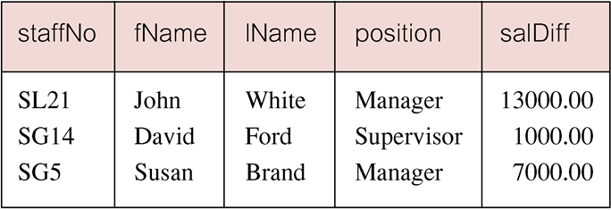
Example 6.20 Subquery with Aggregate
Pearson Education © 2014

Slide 44
Subquery Rules
ORDER BY clause may not be used in a subquery (although it may be used in outermost SELECT).
Subquery SELECT list must consist of a single column name or expression, except for subqueries that use EXISTS.
By default, column names refer to table name in FROM clause of subquery. Can refer to a table in FROM using an alias.
Pearson Education © 2014

Slide 45
Subquery Rules
When subquery is an operand in a comparison, subquery must appear on right-hand side.
A subquery may not be used as an operand in an expression.
Pearson Education © 2014

Slide 46
Example 6.21 Nested subquery: use of IN
List properties handled by staff at ‘163 Main St’.
  SELECT propertyNo, street, city, postcode, type, rooms, rent
  FROM PropertyForRent
  WHERE staffNo IN
    (SELECT staffNo
    FROM Staff
    WHERE branchNo =
    (SELECT branchNo
    FROM Branch
    WHERE street = ‘163 Main St’));
Pearson Education © 2014

Slide 47
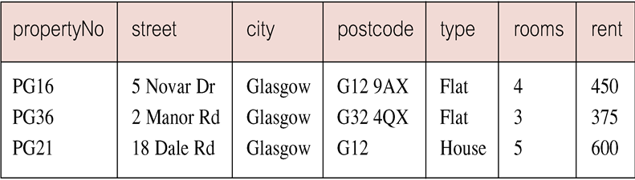
Example 6.21 Nested subquery: use of IN
Pearson Education © 2014

Slide 48
Multi-Table Queries
To perform join, include more than one table in FROM clause.
Use comma as separator and typically include WHERE clause to specify join column(s).
Show part of page 112 figure
Pearson Education © 2014

Slide 49
Example 6.24 Simple Join
List names of all clients who have viewed a property along with any comment supplied.
SELECT c.clientNo, fName, lName,
  propertyNo, comment
  FROM Client c, Viewing v
  WHERE c.clientNo = v.clientNo;
  (What you are joining on Must be a Candidate key in at least one of the tables!)
Pearson Education © 2014

Slide 50
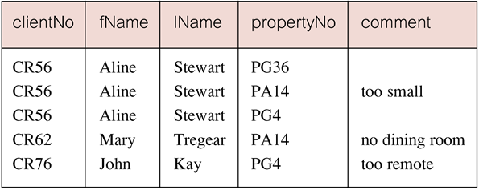
Example 6.24 Simple Join
Only those rows from both tables that have identical values in the clientNo columns (c.clientNo = v.clientNo) are included in result.
Equivalent to equi-join in relational algebra.
Pearson Education © 2014

Slide 51
Alternative JOIN Constructs
SQL provides alternative ways to specify joins:
FROM Client c JOIN Viewing v ON c.clientNo = v.clientNo
FROM Client JOIN Viewing USING clientNo
FROM Client NATURAL JOIN Viewing
In each case, FROM replaces original FROM and WHERE. However, first produces table with two identical clientNo columns.
Pearson Education © 2014

Slide 52
Example 6.25 Sorting a join
For each branch, list numbers and names of staff who manage properties, and properties they manage.
SELECT s.branchNo, s.staffNo, fName, lName,
  propertyNo
  FROM Staff s, PropertyForRent p
  WHERE s.staffNo = p.staffNo
  ORDER BY s.branchNo, s.staffNo, propertyNo;
Pearson Education © 2014

Slide 53
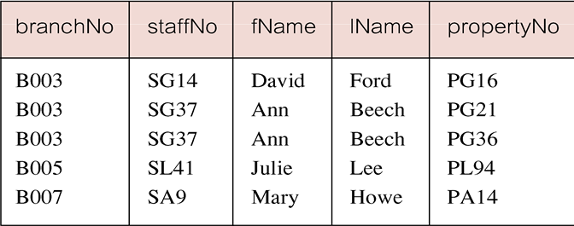
Example 6.25 Sorting a join
Pearson Education © 2014

Slide 54
Example 6.26 Three Table Join
For each branch, list staff who manage properties, including city in which branch is located and properties they manage.
SELECT b.branchNo, b.city, s.staffNo, fName, lName,
  propertyNo
  FROM Branch b, Staff s, PropertyForRent p
  WHERE b.branchNo = s.branchNo AND
  s.staffNo = p.staffNo
  ORDER BY b.branchNo, s.staffNo, propertyNo;
Pearson Education © 2014

Slide 55
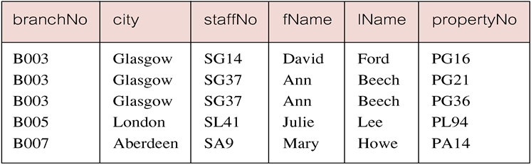
Example 6.26 Three Table Join
Alternative formulation for FROM and WHERE:
  FROM (Branch b JOIN Staff s USING branchNo) AS
  bs JOIN PropertyForRent p USING staffNo
Pearson Education © 2014

Slide 56
Example 6.27 Multiple Grouping Columns
Find number of properties handled by each staff member.
SELECT s.branchNo, s.staffNo, COUNT(*) AS myCount
  FROM Staff s, PropertyForRent p
  WHERE s.staffNo = p.staffNo
  GROUP BY s.branchNo, s.staffNo
  ORDER BY s.branchNo, s.staffNo;
Pearson Education © 2014

Slide 57
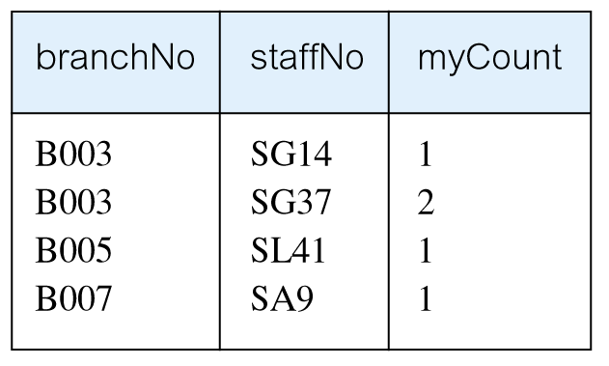
Example 6.27 Multiple Grouping Columns
The rows collapse by branchNo-staffNo
Pearson Education © 2014

Slide 58
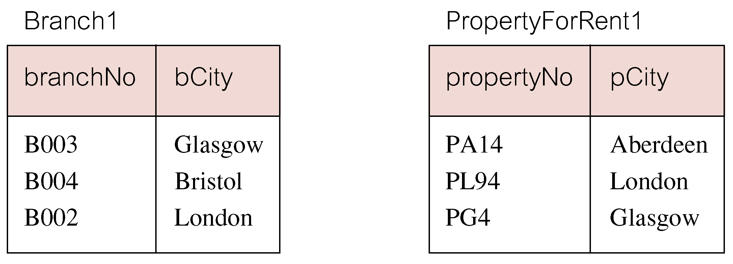
Outer Joins
If one row of a joined table is unmatched, row is omitted from result table.
Outer join operations retain rows that do not satisfy the join condition.
Consider following tables (Write on board) :
Pearson Education © 2014

Slide 59
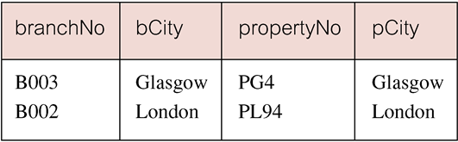
Outer Joins
The (inner) join of these two tables:
  SELECT b.*, p.*
    FROM Branch1 b, PropertyForRent1 p
    WHERE b.bCity = p.pCity;
Pearson Education © 2014

Slide 60
Example 6.28 Left Outer Join
List branches and properties that are in same city along with any unmatched branches.
SELECT b.*, p.*
FROM Branch1 b LEFT JOIN
  PropertyForRent1 p ON b.bCity = p.pCity;
Pearson Education © 2014

Slide 61
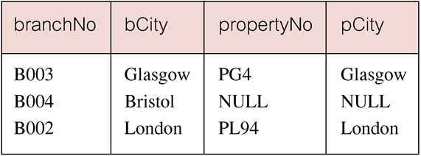
Example 6.28 Left Outer Join
Includes those rows of first (left) table unmatched with rows from second (right) table.
Columns from second table are filled with NULLs (if sort by propertyNo e.g., all NULLs will be on the top).
Pearson Education © 2014

Slide 62
Example 6.29 Right Outer Join
List branches and properties in same city and any unmatched properties.
SELECT b.*, p.*
  FROM Branch1 b RIGHT JOIN
  PropertyForRent1 p ON b.bCity = p.pCity;
Pearson Education © 2014

Slide 63
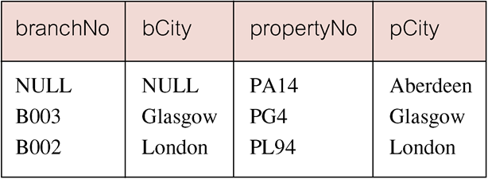
Example 6.29 Right Outer Join
Right Outer join includes those rows of second (right) table that are unmatched with rows from first (left) table.
Columns from first table are filled with NULLs.
Pearson Education © 2014

Slide 64
Union, Intersect, and Difference (Except)
union compatible :
1) Same number of columns in both tables.
2) Each pair of corresponding columns has
the same domain.
Pearson Education © 2014

Slide 65
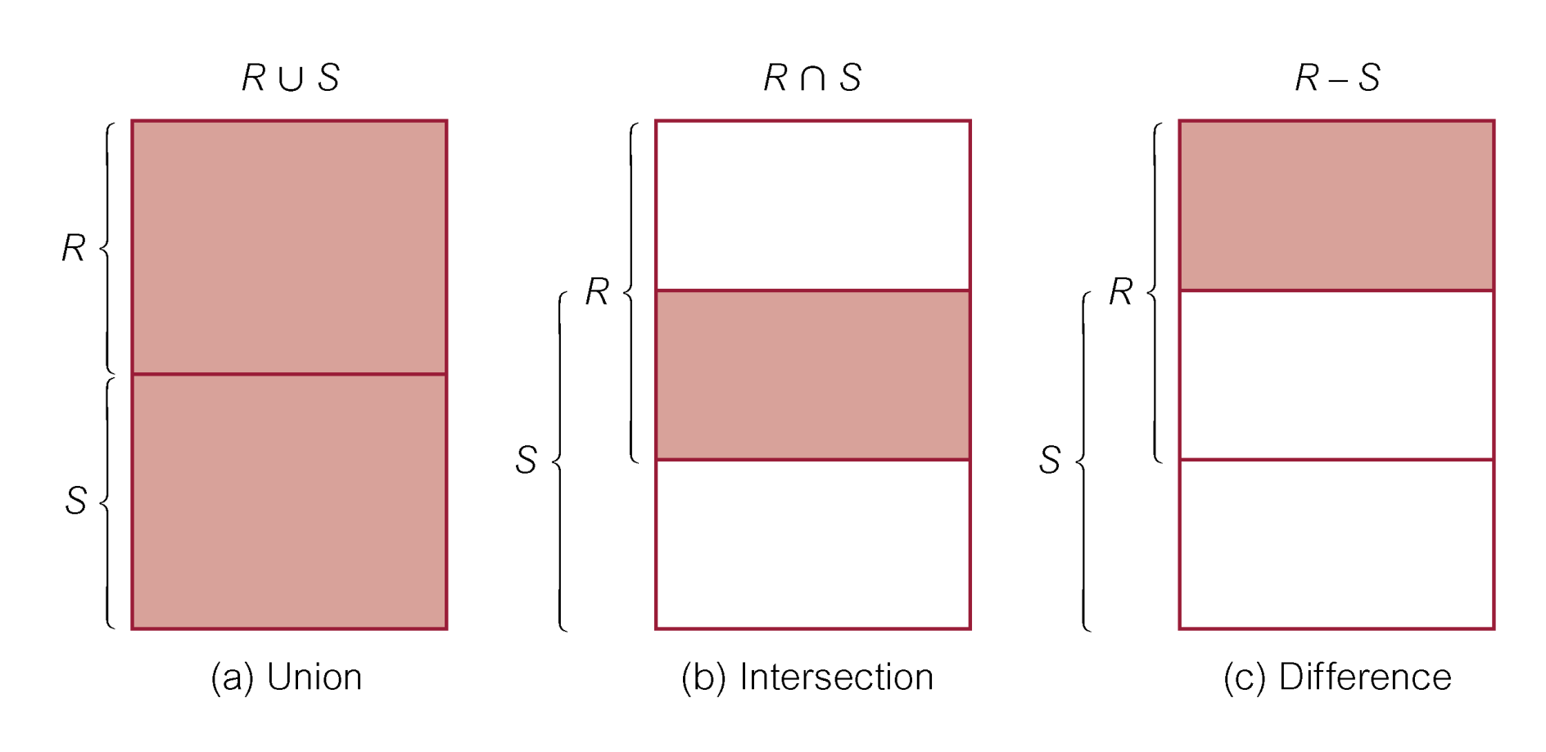
Union, Intersect, and Difference (Except)
Pearson Education © 2014

Slide 66
Example 6.32 Use of UNION
List all cities where there is either a branch office or a property.
(SELECT city
  FROM Branch
  WHERE city IS NOT NULL) UNION
  (SELECT city
  FROM PropertyForRent
  WHERE city IS NOT NULL);
  -- Duplicates are automatically gotten rid of.
Pearson Education © 2014

Slide 67
Example 6.32 Use of UNION
Or
  (SELECT *
  FROM Branch
  WHERE city IS NOT NULL)
  UNION CORRESPONDING BY city
  (SELECT *
  FROM PropertyForRent
  WHERE city IS NOT NULL);
Pearson Education © 2014

Slide 68
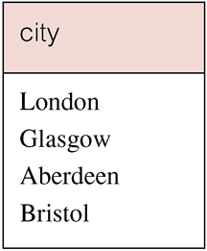
Example 6.32 Use of UNION
Produces result tables from both queries and merges both tables together.
Pearson Education © 2014

Slide 69
Example 6.33 Use of INTERSECT
List all cities where there is both a branch office and a property.
(SELECT city FROM Branch)
  INTERSECT
  (SELECT city FROM PropertyForRent);
Pearson Education © 2014

Slide 70
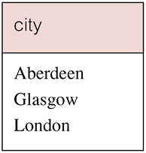
Example 6.33 Use of INTERSECT
Or
  (SELECT * FROM Branch)
  INTERSECT CORRESPONDING BY city
  (SELECT * FROM PropertyForRent);
Pearson Education © 2014

Slide 71
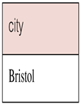
Example 6.34 Use of EXCEPT
List of all cities where there is a branch office but no properties.
(SELECT city FROM Branch)
  EXCEPT
  (SELECT city FROM PropertyForRent);
Or
  (SELECT * FROM Branch)
  EXCEPT CORRESPONDING BY city
  (SELECT * FROM PropertyForRent);
Pearson Education © 2014

Slide 72
Example 6.34 Use of EXCEPT
Could rewrite this query without EXCEPT:
  SELECT DISTINCT city FROM Branch
  WHERE city NOT IN
  (SELECT city FROM PropertyForRent);
Or
  SELECT DISTINCT city FROM Branch b
  WHERE NOT EXISTS
  (SELECT * FROM PropertyForRent p
  WHERE p.city = b.city);
Pearson Education © 2014

Slide 73
Example 6.35 INSERT … VALUES
Insert a new row into Staff table supplying data for all columns.
INSERT INTO Staff
  VALUES (‘SG16’, ‘Alan’, ‘Brown’, ‘Assistant’, ‘M’, Date‘1957-05-25’, 8300, ‘B003’);
Pearson Education © 2014

Slide 74
Example 6.36 INSERT using Defaults
Insert a new row into Staff table supplying data for all mandatory columns.
INSERT INTO Staff (staffNo, fName, lName,
  position, salary, branchNo)
  VALUES (‘SG44’, ‘Anne’, ‘Jones’,
  ‘Assistant’, 8100, ‘B003’);
Or
  INSERT INTO Staff
  VALUES (‘SG44’, ‘Anne’, ‘Jones’, ‘Assistant’, NULL,
  NULL, 8100, ‘B003’);
Pearson Education © 2014

Slide 75
INSERT … SELECT
Second form of INSERT allows multiple rows to be copied from one or more tables to another:
INSERT INTO TableName [ (columnList) ]
  SELECT ...
Pearson Education © 2014

Slide 76
Example 6.38/39 UPDATE All Rows
Give all staff a 3% pay increase.
UPDATE Staff
  SET salary = salary*1.03;
Give all Managers a 5% pay increase.
UPDATE Staff
  SET salary = salary*1.05
  WHERE position = ‘Manager’;
  -- Always check your answers (especially numbers) in the table, and, backup the table!
Pearson Education © 2014

Slide 77
Example 6.40 UPDATE Multiple Columns
Promote David Ford (staffNo=‘SG14’) to Manager and change his salary to £18,000.
UPDATE Staff
  SET position = ‘Manager’, salary = 18000
  WHERE staffNo = ‘SG14’;
  Could do a ‘Select’ Before you do the Update to
  see which rows would be changed.
Pearson Education © 2014

Slide 78
Example 6.41/42 DELETE Specific Rows
Delete all viewings that relate to property PG4.
DELETE FROM Viewing
  WHERE propertyNo = ‘PG4’;
Delete all records from the Viewing table.
  DELETE FROM Viewing;
  -- All the data is now gone!! Backup the table first!!
Pearson Education © 2014

Slide 79
Mention the empty String ‘’
It is Not Null

Slide 80
Transaction Support
  Transaction
  Action, or series of actions, carried out by user or application, which reads or updates contents of database.
Logical unit of work on the database.
Application program is series of transactions with non-database processing in between.
Transforms database from one consistent state to another, although consistency may be violated during transaction.
Pearson Education © 2014

Slide 81
Properties of Transactions
Four basic (ACID) properties that define a transaction are:
Atomicity ‘All or nothing’ property.
Consistency Must transform database from one consistent state to another.
Isolation Partial effects of incomplete transactions should not be visible to other transactions.
Durability Effects of a committed transaction are permanent and must not be lost because of later failure.
Pearson Education © 2014

Slide 82
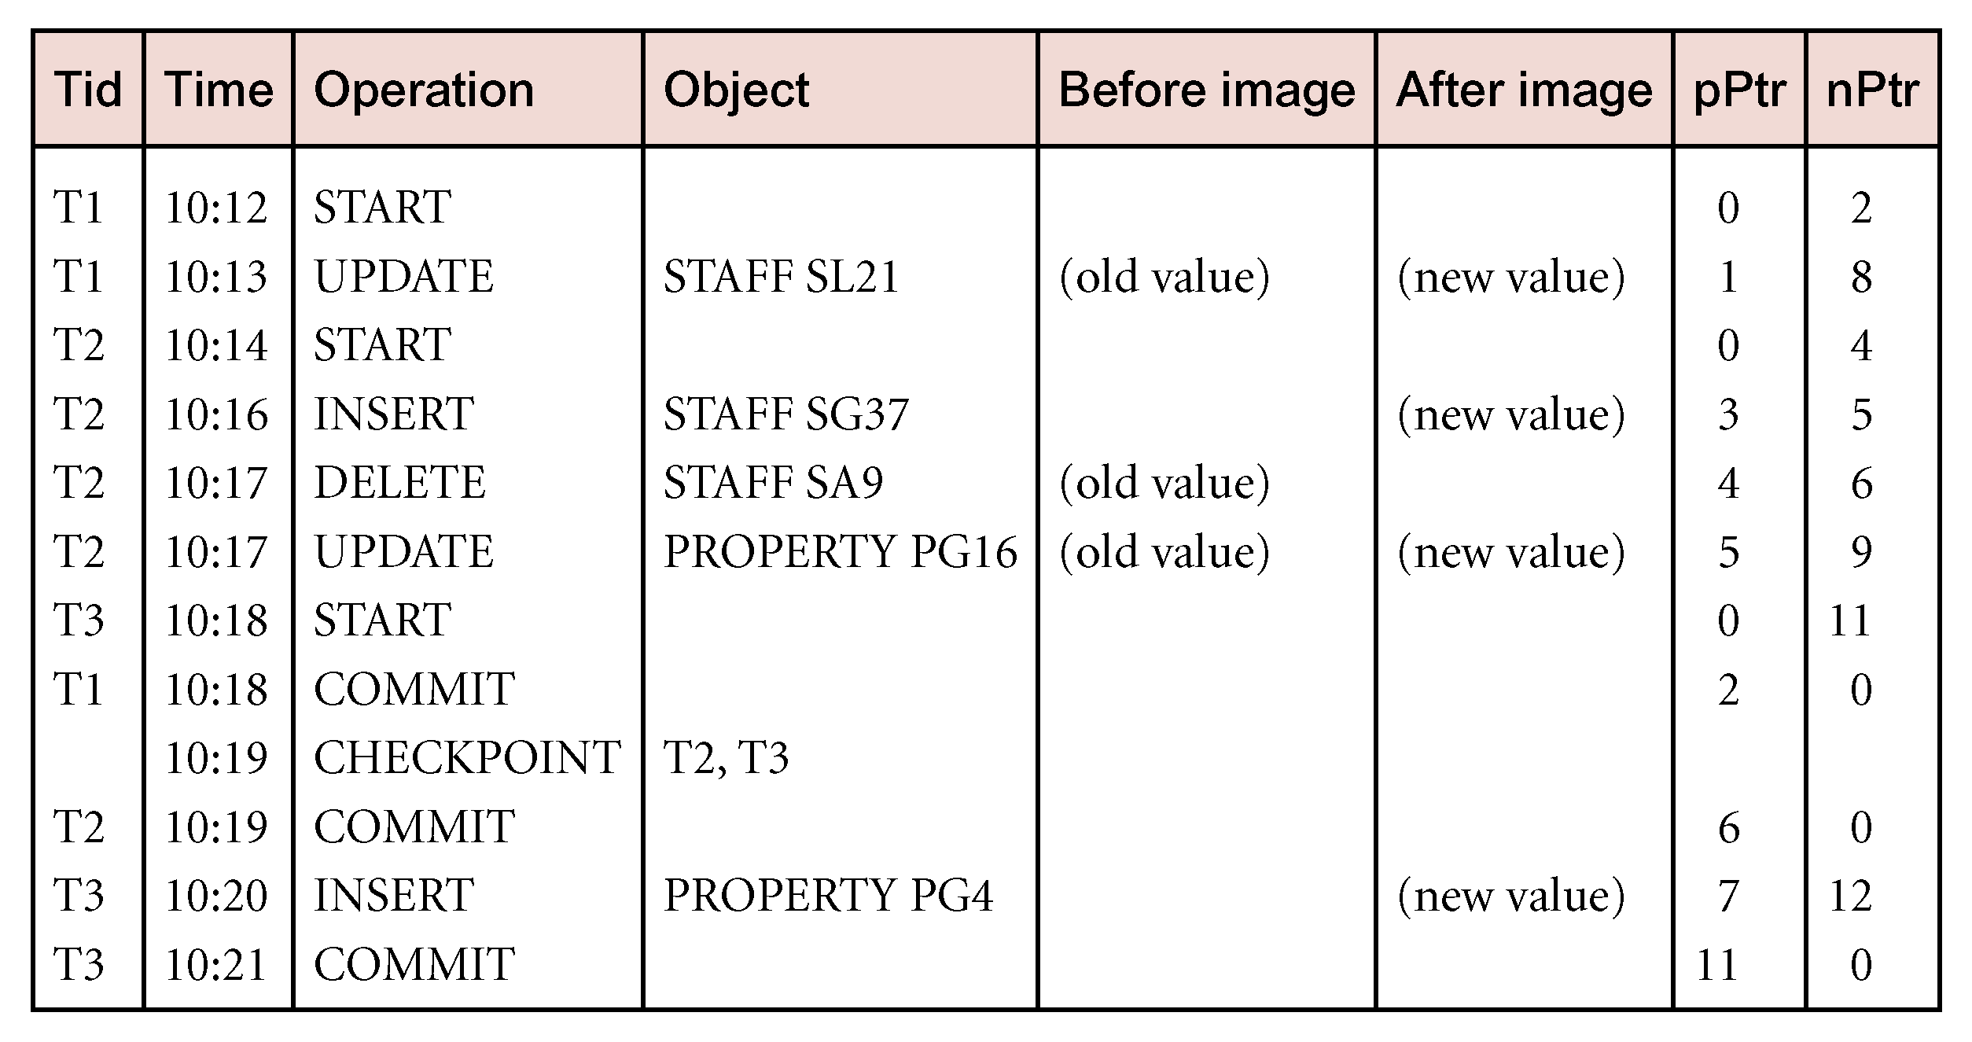
Sample Log File
Pearson Education © 2014

Slide 83
Chapter 23
Query Processing
Pearson Education © 2014

Slide 84
Chapter 24
Distributed DBMSs – Concepts and Design
Pearson Education © 2014

Slide 85
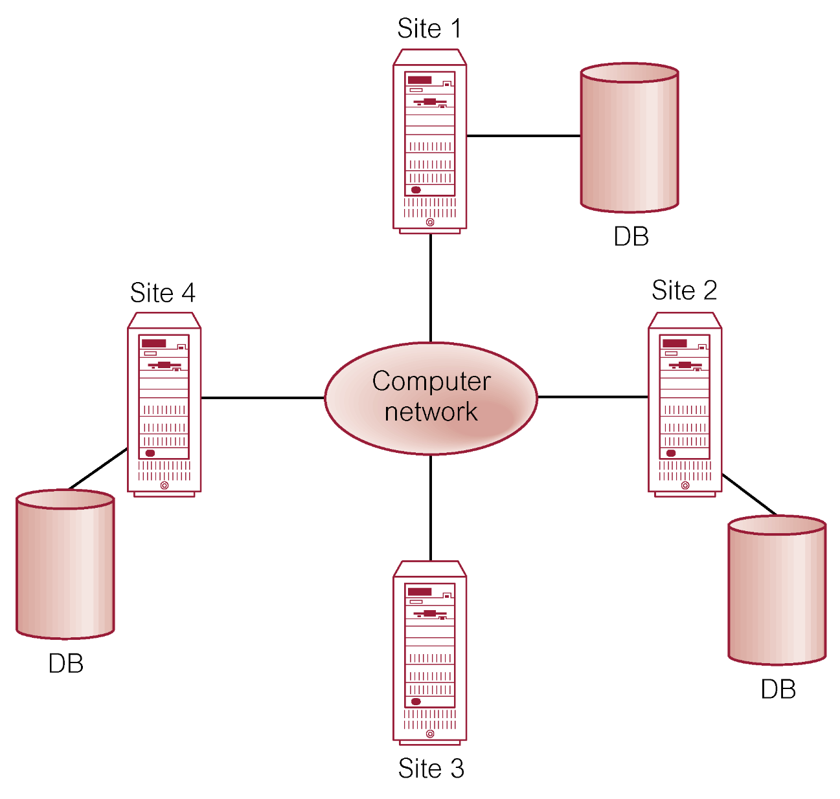
Distributed DBMS
Pearson Education © 2014

Slide 86
Performance Transparency - Example
Property(propNo, city) 10000 records in London
Client(clientNo,maxPrice) 100000 records in Glasgow
Viewing(propNo, clientNo) 1000000 records in London
SELECT p.propNo
FROM Property p INNER JOIN
(Client c INNER JOIN Viewing v ON c.clientNo = v.clientNo)
ON p.propNo = v.propNo
WHERE p.city=‘Aberdeen’ AND c.maxPrice > 200000;
Pearson Education © 2014

Slide 87
Performance Transparency - Example
Assume:
Each tuple in each relation is 100 characters long.
10 renters with maximum price greater than £200,000.
100,000 viewings for properties in Aberdeen.
Computation time negligible compared to communication time.
Pearson Education © 2014

Slide 88
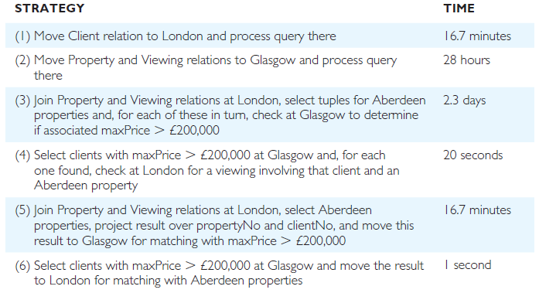
Performance Transparency - Example
Pearson Education © 2014

